Slide 1
WINCHBURGH ACADEMY
Parent Information Evening
Q & A
12th May, 2022 – 6.30pm
@wlwinchburgh_ac
wlwinchburgh-ac@westlothian.org.uk
Website coming soon (under construction)

Slide 2
WINCHBURGH ACADEMY
Aims:
1/ Officially meet ‘Our Academy Staff Team’
2/ Further develop your understanding of what ‘Our Academy’ is going to be like
3/ Be aware of our transition programme and events for those who are moving to Winchburgh Academy in August
@wlwinchburgh_ac
wlwinchburgh-ac@westlothian.org.uk
Website coming soon (under construction)

Slide 3
WINCHBURGH ACADEMY
Welcome:
Mrs. Karen Borthwick Acting PT English, Humanities & Languages
Mrs. Sarah Oliver Acting PT Support
Miss. Laura Duffin Acting PT Maths & Technologies
Mrs. Stacey McCallum Acting PT Science & Art
Mr. Colin Kerr Acting DHT
Ms. Jennifer Brydon Area Business Support Manager
@wlwinchburgh_ac
wlwinchburgh-ac@westlothian.org.uk
Website coming soon (under construction)

Slide 4
WINCHBURGH ACADEMY
Coming Soon:
Mrs. Danielle Naules Modern Languages (French & Spanish) 0.2 FTE
Ms. Aimi Chisholm Art 0.2 FTE
Mrs. Andrea Cameron Music 0.2 FTE
Ms. Amy Collings HFT (Home Economics) 0.2 FTE
Ms. Joanna Reilly Admin. Assistant (School Office) 1 FTE (32 hrs per week)
And… A Pupil Support Worker, Facilities Management, Other Relevant Teaching Staff
@wlwinchburgh_ac
wlwinchburgh-ac@westlothian.org.uk
Website coming soon (under construction)

Slide 5
WINCHBURGH ACADEMY
Our Academy Badge & Tie
‘Our Academy’ Identity Focus Group
Surveys
Badge & Tie
Additional Uniform Items/Styles tbc…
@wlwinchburgh_ac
wlwinchburgh-ac@westlothian.org.uk
Website coming soon (under construction)

Slide 6
WINCHBURGH ACADEMY
Transition Events/Programme:
@wlwinchburgh_ac
wlwinchburgh-ac@westlothian.org.uk
Website coming soon (under construction)

Slide 7
WINCHBURGH ACADEMY
@wlwinchburgh_ac
wlwinchburgh-ac@westlothian.org.uk
Website coming soon (under construction)

Slide 8
WINCHBURGH ACADEMY
Transition (continued):
Summer School (1st or 2nd week in August (tbc) in Winchburgh Academy)
WOW Week (Winchburgh Open Week) w/b Tuesday 16th August
Series of Parent/Family Events (continuing on Tuesday 24th May, 6.30pm in Winchburgh Primary School with ‘Our Academy’ Values Workshop
Enhanced Transition as/where required as arranged by Mrs. Oliver (gathering all information from Primary Schools including data, CPM, IEPs, Support. If you haven’t already, you’ll hear from Mrs. Oliver very soon.
@wlwinchburgh_ac
wlwinchburgh-ac@westlothian.org.uk
Website coming soon (under construction)

Slide 9
WINCHBURGH ACADEMY
Shape of Our Academy School Day:
Session 2022/23
3 small classes (approximately 16/17 per class)
4 periods per day Monday to Thursday and 2 periods on Fridays (featuring extended learning opportunities
Based on research from recent Scottish Education – OECD Report, ASN Review, CFE Curriculum Refresh. Summary – develop skills and knowledge in relevant ways based on the evolving and ever changnin world we live in. Whilst ensuring curriculum entitlements – steer more towards the linking of subject areas planning and working together rather than purely discrete subject teaching all of the time (IDL). Importance of health & wellbeing
COLLABORATION – COLLABORATION - COLLABORATION
@wlwinchburgh_ac
wlwinchburgh-ac@westlothian.org.uk
Website coming soon (under construction)

Slide 10
WINCHBURGH ACADEMY
Shape of Our Academy School Day:
Session 2022/23 EXAMPLE (TBC)
Class | Daily Check In Adult (Support & Wellbeing | Principal Teacher of Support
1W1 | Mrs. Borthwick | Mrs. Oliver
1W2 | Mrs. McCallum | Mrs. Oliver
1W3 | Mrs. Duffin | Mrs. Oliver
Mr. Kerr (S1 Year Head & DHT)
Mr. Mitchell (HT)
@wlwinchburgh_ac
wlwinchburgh-ac@westlothian.org.uk
Website coming soon (under construction)

Slide 11
WINCHBURGH ACADEMY
Summary (General Contacts – 2022/23):
Step 1 Daily Check In Teacher
Step 2 PT Support – Mrs. Oliver
Step 3 S1 Year Head (DHT) – Mr. Kerr
Step 4 HT – Mr. Mitchell
We will all know your child very, very well
@wlwinchburgh_ac
wlwinchburgh-ac@westlothian.org.uk
Website coming soon (under construction)

Slide 12
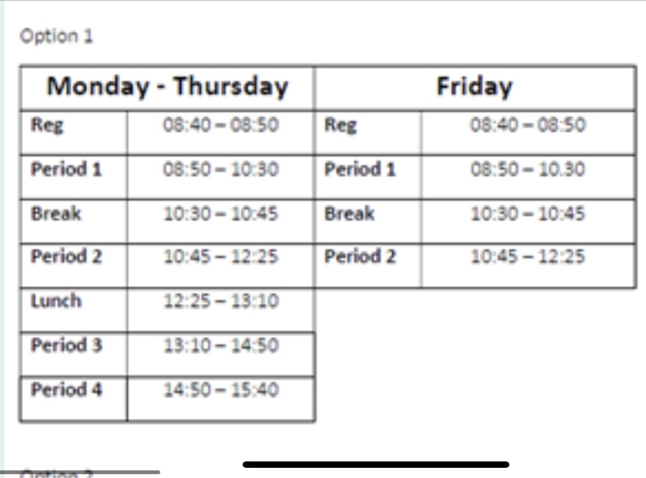
WINCHBURGH ACADEMY
Shape of School Day:
@wlwinchburgh_ac
wlwinchburgh-ac@westlothian.org.uk
Website coming soon (under construction)

Slide 13
WINCHBURGH ACADEMY
Following discussions with 'Our Academy' young people and parents/families during recent meetings, Q & A sessions, and Parent Council discussions we are now ready to confirm the initial shape of the school day at Winchburgh Academy from August 2022.
Additionally, working in partnership with colleagues from education across Scotland and beyond, we are following advice and findings from emerging research and policy.
Our school day will be a little different from many other schools as we are planning longer classes most of the time, but fewer of them in a week.
Longer periods include these advantages:
better relationships between pupils and staff
opportunities for deeper, more collaborative learning (including outdoor learning/visits out-with school building)
less time moving between classes (less transitions)
more continuous time provides opportunities for innovative learning, teaching, and assessment
pupils have less to juggle each day, promoting better support and mental load/well-being
@wlwinchburgh_ac
wlwinchburgh-ac@westlothian.org.uk
Website coming soon (under construction)

Slide 14
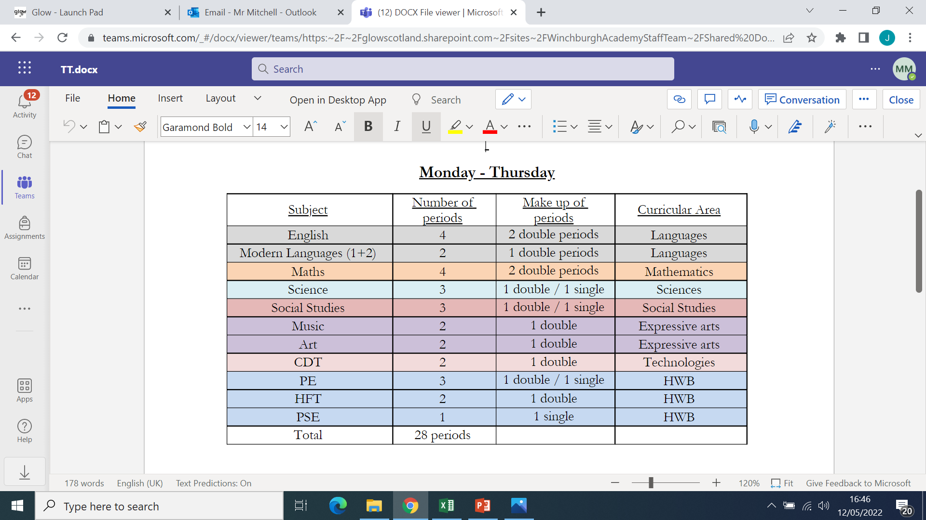
WINCHBURGH ACADEMY
@wlwinchburgh_ac
wlwinchburgh-ac@westlothian.org.uk
Website coming soon (under construction)

Slide 15
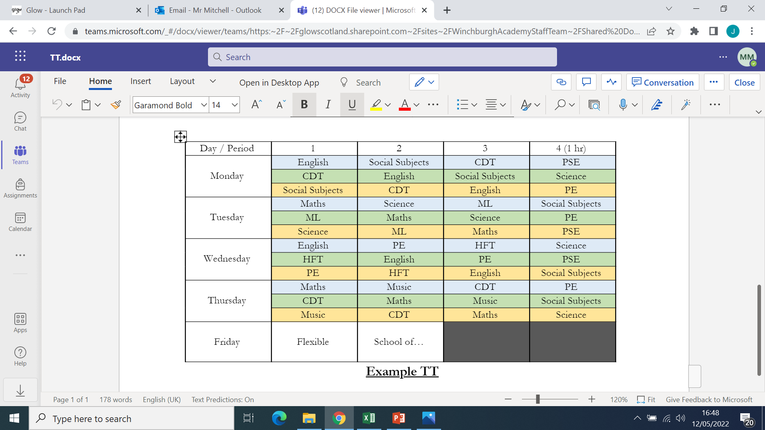
WINCHBURGH ACADEMY
@wlwinchburgh_ac
wlwinchburgh-ac@westlothian.org.uk
Website coming soon (under construction)

Slide 16
WINCHBURGH ACADEMY
Aims:
1/ Officially meet ‘Our Academy Staff Team’
2/ Further develop your understanding of what ‘Our Academy’ is going to be like
3/ Be aware of our transition programme and events for those who are moving to Winchburgh Academy in August
@wlwinchburgh_ac
wlwinchburgh-ac@westlothian.org.uk
Website coming soon (under construction)

Slide 17
WINCHBURGH ACADEMY
Questions?
THANK YOU FOR ATTENDING & FOR YOUR SUPPORT – Hopefully see you in-person in Winchburgh Primary School at 6.30pm on Tuesday 24th May
Remember - ‘Your Academy’ Needs You – Working Groups (Curriculum Design, Tracking & Monitoring, Rewards, Wider Life & Ethos, Learning, Teaching & Assessment
@wlwinchburgh_ac
wlwinchburgh-ac@westlothian.org.uk
Website coming soon (under construction)

